Slide 1
Notes:
Good afternoon! My name is _________ with the United States Navy.
Today I’m going to tell you about the Navy’s Nuclear program , the most advanced program in the military.

Slide 2


(recruiter intro
here)
(INCLUDE PERSONAL INFO HERE:)
Why did you join the Navy?
How long have you been in the Navy?
What was your rate?
Where have you served?
Notes:
Let me introduce myself and tell you a little bit about me….
(Populate this slide with your personal information - bullet points are suggested content, input whatever details you prefer)
(Speak to your job as a recruiter)
ENSURE ABOVE COPY IS DELETED!!

Slide 3
Notes:
The Navy was founded in 1775.
One of 7 uniform services in the United States and 1 of 5 armed forces.
Largest Navy in the world, greater than the next 13 Navy’s COMBINED with over 330,000 active duty Sailor and over 130 essential job field.
Worlds largest aircraft carrier fleets including 289 deployable battle ships and over 100 ports of call.

Slide 4
Notes:
Today, we are going to discuss the ways in which the Navy can help secure your future, show you global adventure and provide money for education.
We will also discuss the rewards that are available for joining and the long-term benefits of being a member of the Navy.

Slide 5
Notes:
Nuclear power plants emit far fewer atmospheric pollutants than the competition, its comparable to wind power.
Nuclear power costs less and is the most reliable source of electricity.
You can store/transport more nuclear fuel than other fuel sources at the same volume.

Slide 6
Notes:
Why was it important to build a Nuclear Navy?
Nuclear power has made it possible to potentially go up to 40 years without refueling
Its cleaner, quieter and lasts longer than other fuels

Slide 7
Notes:
As we discussed, the uranium fuel pellets aka Uranium-235, nucleus absorbs an extra, slow-moving neutron.
Nuclear reactors use Uranium-235 as fuel.
After absorbing the neutron, the nucleus becomes uranium-236, which is highly unstable.
The nucleus splits into two “fission products,” releasing a significant amount of energy as well as 2-3 neutrons.

Slide 8
Notes:
The released neutrons can be absorbed by other Uranium-235 nuclei, causing a chain reaction.
A nuclear reactor is used to control this chain reaction

Slide 9
Notes:
The image on the right is a pressurized water reactor and is the type of reactor used in the majority of the world’s nuclear power plants.
The Reactor Plant uses three systems (Primary, Secondary, and Condensate). The Primary system is the darkest blue, the secondary system is bright blue (water from the condenser) and white (steam), and the condensate cooling system is light blue is cooling water used to condense steam back to water for reuse in the secondary system.
The left part of this image is the reactor pressure vessel where fission occurs, as we just discussed.
In the second step of this process, pressurized water runs through the coils of the steam generator
The heat vaporizes water in a secondary loop, making steam which then travels through the steam line.

Slide 10
Notes:
Navy nuclear power has a long proud history and is one of the largest nuclear organizations and one of the most advanced programs in the world.
The Navy has a stellar safety record when it comes to nuclear power.
The Navy has sailed 139 million miles without a single nuclear accident, which is approximately 5,582 trips around the world or approximately 290 round trips to the moon.

Slide 11
Notes:
Nuclear-powered aircraft carriers are the most sophisticated in the world and include opportunities for overseas deployments and foreign port visits
With 400+ nuclear ratings on board, it is the most protected ship in the fleet and the forefront of Navy’s power projection.
Remember when I said we have 289 deployable battle ships? They don’t run on unleaded fuel.

Slide 12
Notes:
Here are the 9 bases where you could potentially be stationed.
(Feel free to add context or color to the slide.)

Slide 13
Notes:
There are three types of Nuclear Operations jobs for enlisted Sailors. Responsibilities depend on your training, interests and designation.
All three of these ratings are eligible to receive up to a $40,000 bonus for first-time enlistment and up to a $100,000 bonus for re-enlistment.
Nuclear technicians, power plant operators and subsystems specialists are responsible for keeping vital Naval submarines and aircraft carriers running.
These highly trained, hands-on professionals perform the complex technical functions that are at the core of sub and carrier capabilities.
Their job involves everything from operating nuclear propulsion plant machinery, to controlling auxiliary equipment that supports Naval reactors, to maintaining various electronic, propulsion and weapons systems.

Slide 14
Notes:
You’ll receive training on a curriculum designed by MIT
Your training will give you the opportunity to first learn the curriculum in “A” school and Power school. Then you’ll be given an opportunity to apply the principles in a real life setting in the Power Training Unit.
All while receiving a paycheck!
Upon completing boot camp, everyone starts at “A” school.
Here you’ll live in college-style dorms.
You’ll be busy with school but will have time to explore and enjoy Charleston.

Slide 15
Notes:
(Speak to the benefits listed above )
Through this Nuclear Power Propulsion program you are promoted to the rank of E3 before ever attending any type of training which normally takes 18 months
You’re given a promotion before ever lifting a finger to work. If you can get a head start in life, why not take it?
And upon graduation of A School, you will receive and automatic promotion to E4.

Slide 16
Notes:
Let’s talk about college credits – you could earn 70+ credit hours, a similar education could cost up to $200,000.
Among the Class of 2018, 69% of college students took out student loans, and they graduated with an average debt of $29,800.
Average monthly student loan payment: $393.
(Data from, as of 2/4/19: https://studentloanhero.com/student-loan-debt-statistics/).
Similar education could cost $200,000
You are earning college credits while receiving a paycheck.

Slide 17
Notes:
You are setting yourself up for the future. Here is what you may expect once you leave the Navy.
Some find, the most difficult decision you may have to make, after the Navy, is where you want to live and work because there are so many opportunities.
Median household income is $61,372
Average starting salary for a college graduate is ~$50,390

Slide 18
Notes:
There are multiple ways to join the Navy but so many ways to make it your own.

Slide 19
Notes:
When you join as an enlisted sailor you start your journey at basic training in Great Lakes, IL. You will train for a specific job in a variety of different fields with regular promotions.

Slide 20
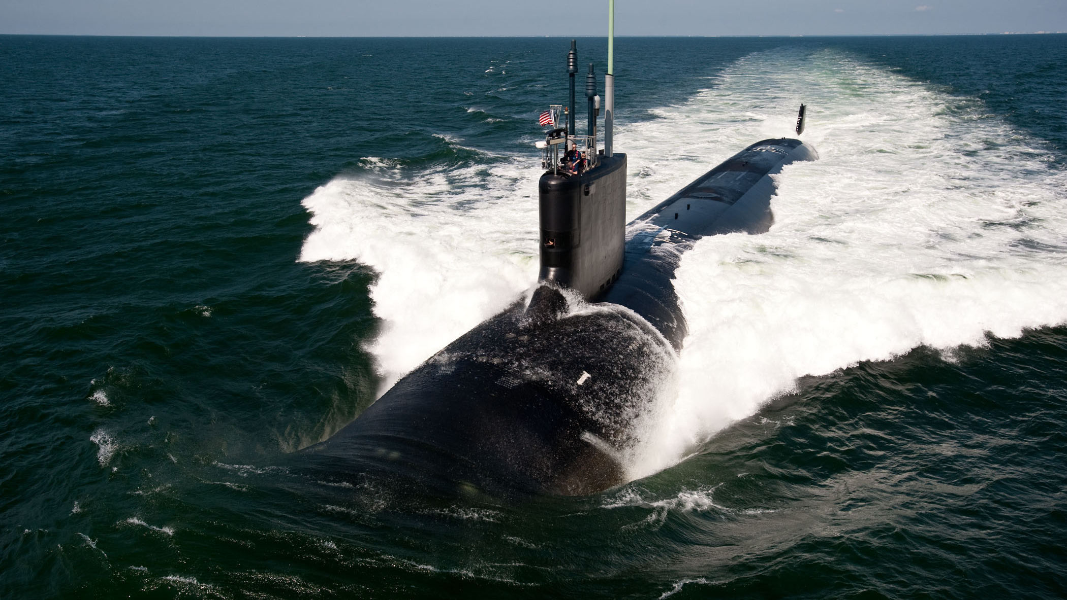
Questions?
CONTACT INFO:
Notes:
Talk to me! I’d love to tell you more about life in the Navy and answer any questions you may have.
(Input your contact information – phone, email, social media handles, and/or your personalized QR or Snapchat code.)
(If inserting a code, encourage students to take a picture and save your contact information.)

